Slide 1
Classifying images of stars & galaxy and asteroids using Convolutional Neural Networks
Authors
Dongwei Sun
UC Riverside
900 University Ave,
Riverside, CA 92521
Ponmanikandan Velmurugan
UC Riverside
900 University Ave,
Riverside, CA 92521
Ivan Neto
UC Riverside
900 University Ave, Riverside, CA 92521
Julian Beaulieu
Texas A&M University
400 Bizzell St,
College Station, TX 77843
Kai-Chun Chen
UC Riverside
900 University Ave, Riverside, CA 92521

Slide 2
Outline
Team 4 Introduction
Background
Mini Challenge
Major Challenge
Summary
Acknowledgement

Slide 3
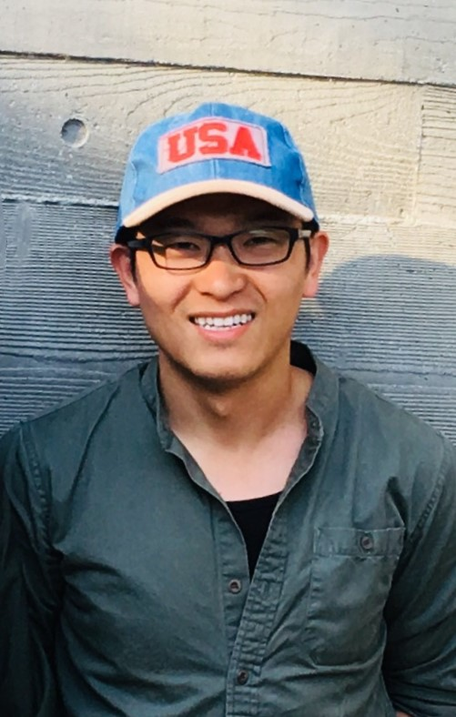

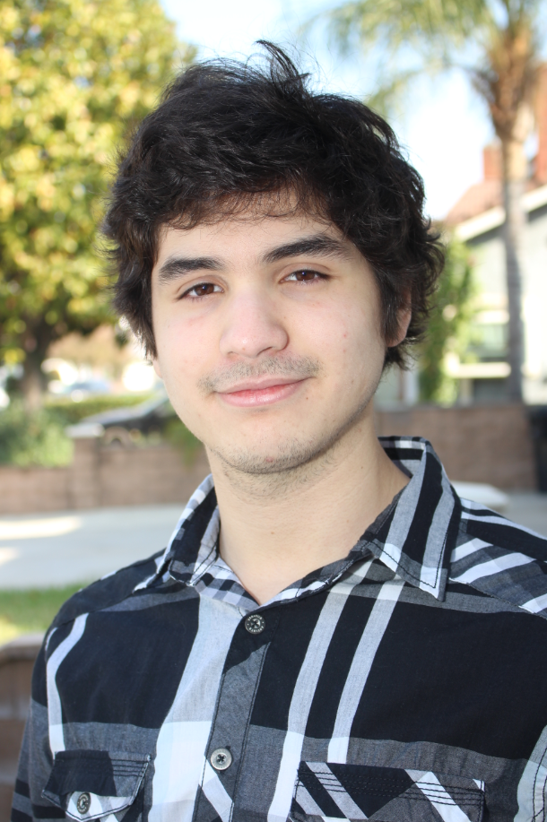

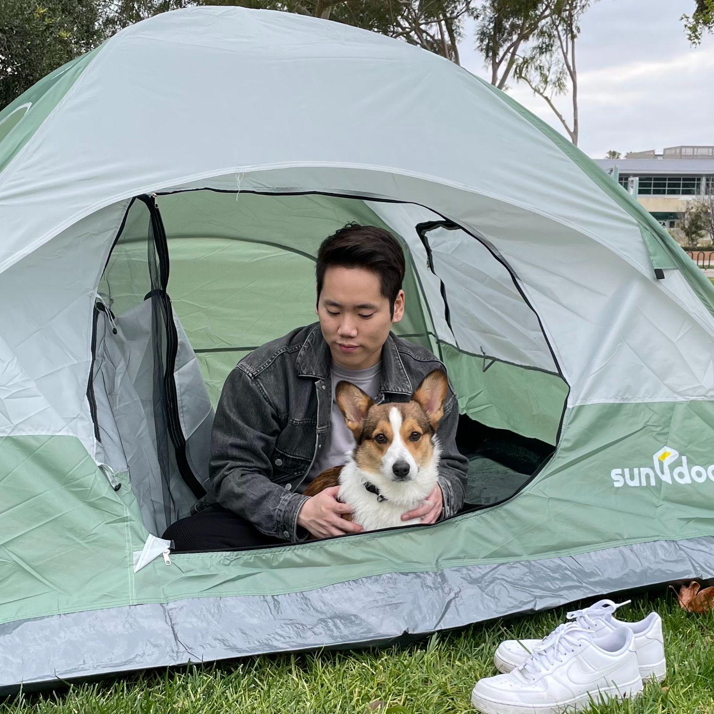
Team 4 Introduction
Dongwei Sun
UC Riverside
900 University Ave, Riverside, CA 92521
Ponmanikandan Velmurugan
UC Riverside
900 University Ave, Riverside, CA 92521
Ivan Neto
UC Riverside
900 University Ave, Riverside, CA 92521
Kai-Chun Chen
UC Riverside
900 University Ave, Riverside, CA 92521
Julian Beaulieu
Texas A&M University
400 Bizzell St, College Station, TX 77843
Notes:
Dongwei

Slide 4
Outline
Team 4 Introduction
Background
Mini Challenge
Major Challenge
Summary
Acknowledgement

Slide 5
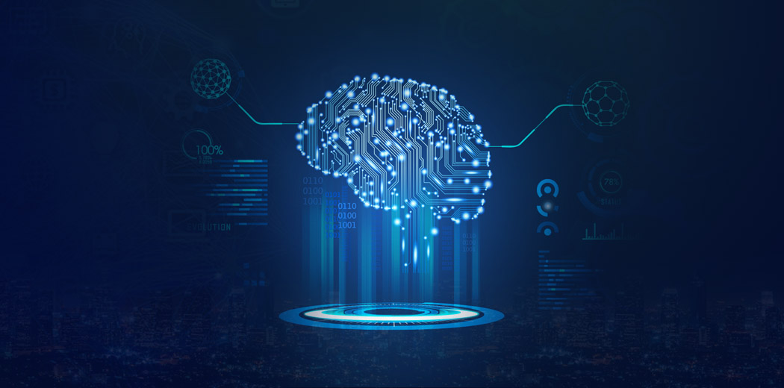
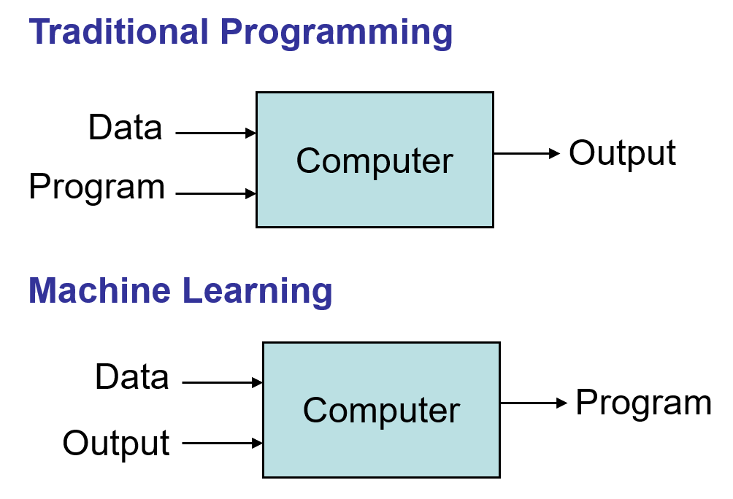
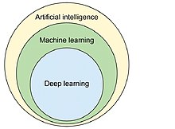
Introduction of Machine Learning
Introduction of Machine Learning
Fig.1
Fig.2

Slide 6

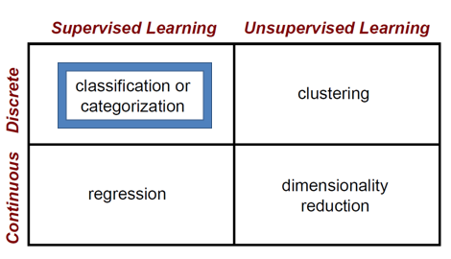
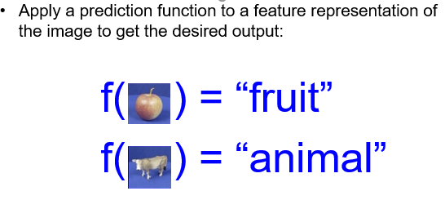
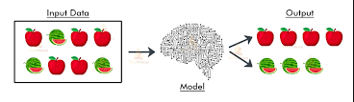
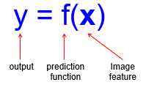
Fig.3
Supervised Learning
Unsupervised Learning
Fig.5
Fig.4

Slide 7
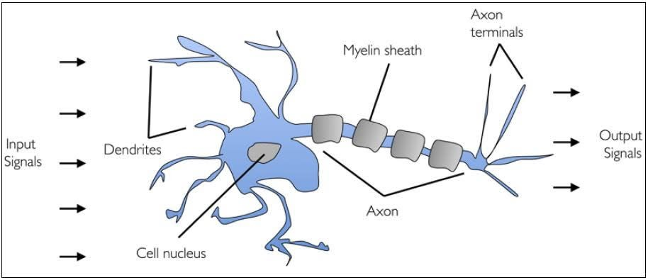
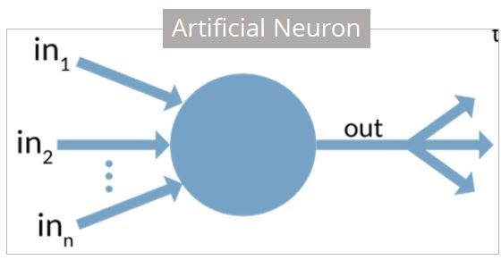
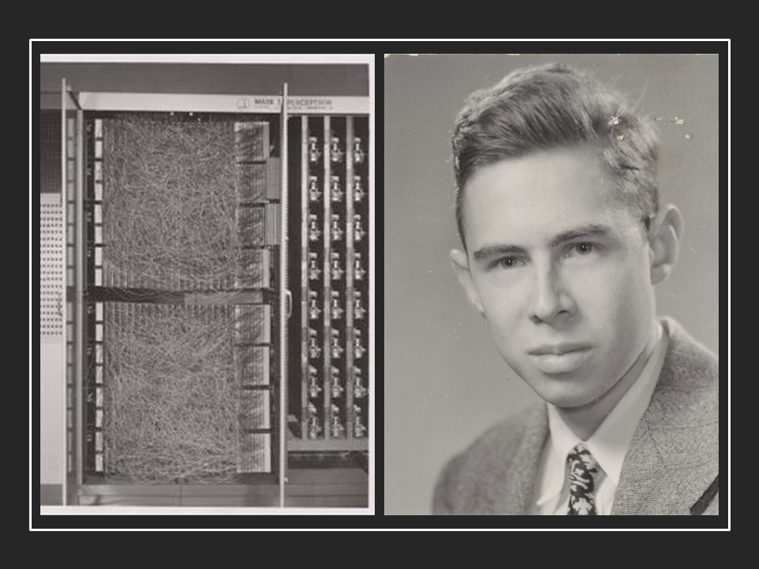
Neural Networks
Human Neuron
Mimic the operations of a human brain to recognize relationships between vast amounts of data
Neuron - Basic computation unit [input - process - output]
Activation Function - Defines the output for an input
Linear
ReLU
Heaviside
Perceptron - Simplest type of Neural Network - Classifier
Left: Mark I Perceptron machine - Image Recognition
Right: Dr. Frank Rosenblatt
PhD Experimental Psychology, Cornell, 1956
Source: https://machinelearningknowledge.ai/timeline/perceptron-neuron-that-can-learn/
Source: https://www.simplilearn.com/tutorials/deep-learning-tutorial/perceptron
Notes:
The idea of neural networks unsurprisingly comes from human brain. The basic idea is to find a way to mimic the functionality of the brain. Neuron is the basic unit of computation in neural networks. They receive an input, do some processing and produce an output. The neurons can be connected to any number of neurons. Now, back to the processing part of the neuron. This is called the activation function, there are different activation functions such as Linear (linear combination of input), ReLU (output = input if input > 0), Heaviside (pronounced as heavy-side)(output = 1 if input > 0 else 0). Perceptron is the simplest type of neural network consisting of a single neuron. The below image consists of the initial Mark I perceptron on the left which was used for Image Recognition and Dr. Frank Rosenblatt who invented the perceptron algorithm at cornell aeronautical laboratory.

Slide 8


Neural Networks
Multiple perceptron layers (MLPs) - Welcomes non-linearity
Learning with Forward and Backward propagations
Forward Pass - Make predictions
Backward Pass - Adjust weights with observed loss
Source: https://machinelearningknowledge.ai/animated-explanation-of-feed-forward-neural-network-architecture/
Source: https://xkcd.com/1838/
Notes:
However, a single layer of perceptrons was only able to recognize limited set of classes. This was overcame with the additional layers of perceptrons which enabled the classification of previously non-separable classes. Moving on into the working of a neural network, there are two types of passes or propagation called forward and backward progations. First, the model is initialized with random weights and predictions are made with the forward propagation. Then, with the output the loss is calculated and used along with the slope at each layer to adjust the weights during backward propagation. The comic is a funny way to represent the working of the neural network.

Slide 9

Convolutional Neural Network
Source: https://towardsdatascience.com/a-comprehensive-guide-to-convolutional-neural-networks-the-eli5-way-3bd2b1164a53
Notes:
Moving on to another kind of neural networks, the convolutional neural network, the process of forward and backward propagations remains the same. But the different layers are used in feature learning phase and classification phase. Feature learning phase consist of identifying and learning the distinct features for a class (for example, different characteristic of the face...eyes, ears, nose) using filters that are learnt through backpropagation. The classification phase is similar to earlier multilayer perceptron in which we try to predict the class with observed features. Other layers such as Pooling, Normalization is used to reduce the image size and dropout is used to reduce overfitting.

Slide 10
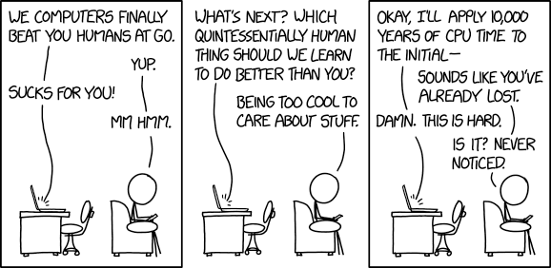
Cannot Model Everything
Source: https://xkcd.com/1875/
Notes:
This concludes the background information of challenge! Something to remember. Not everything can be modeled!

Slide 11
Outline
Team 4 Introduction
Background
Mini Challenge
Major Challenge
Summary
Acknowledgement

Slide 12
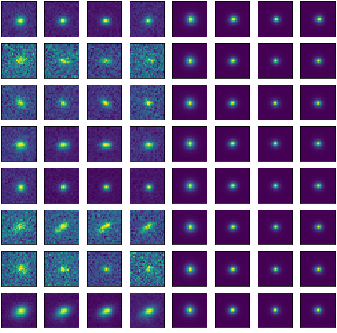
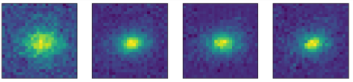
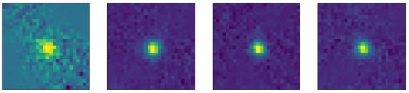
Mini Challenge - Intro
Star vs. Galaxy Classification
~ 34,000 images
8 channels per image
First 4 channels seem to be more indicative and rich.
Last 4 channels might have some hidden features that a model could detect
Class = 0
galaxy
Class = 1
star
Notes:
Dongwei

Slide 13
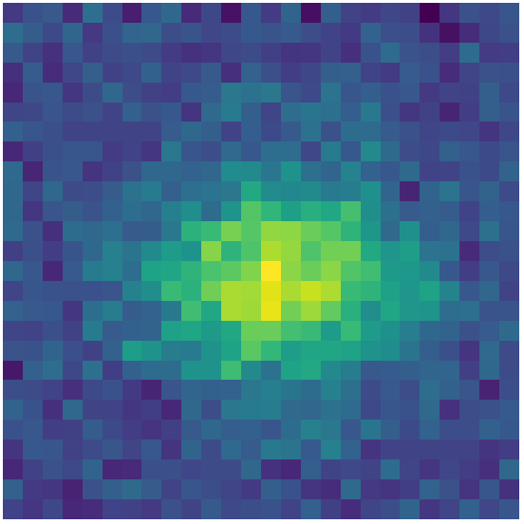
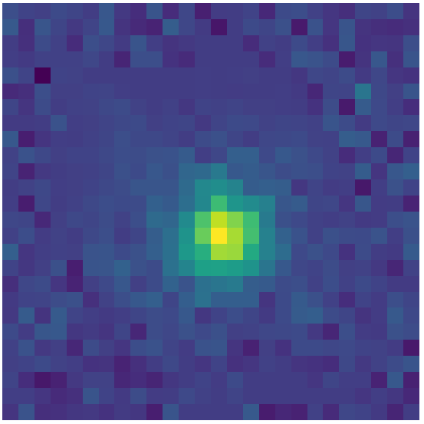
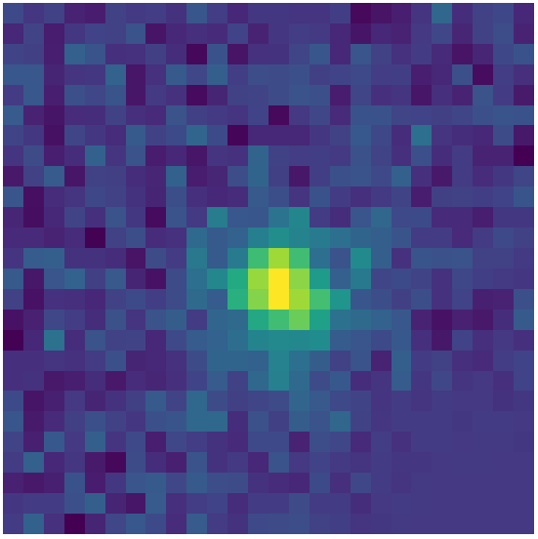
Mini Challenge - Intro
Aim
Differentiate between star and galaxy 26x26 images using Deep Learning Models.
Class = ???
Class = ???
Class = ???
Notes:
Dongwei

Slide 14
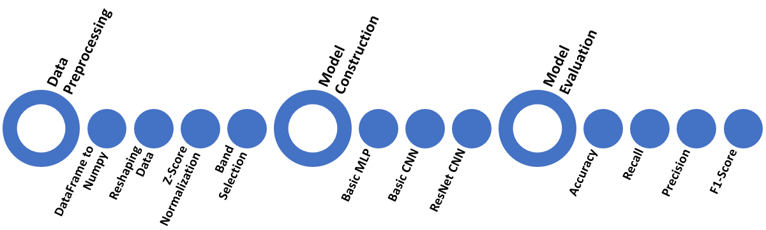
Mini Challenge - Methodology
Model Construction
We decided on three different models, to see which one would perform the best on this data set.
Data Preprocessing
We had to convert Pandas DataFrame to several Numpy arrays
Reshaped data to (26, 26)
Normalized using z-score
Selected all 8 bands
Model Evaluation
Accuracy, Precision, and Recall scores (both micro and macro)
F1 Score and classification reports for every model
Notes:
Dongwei

Slide 15
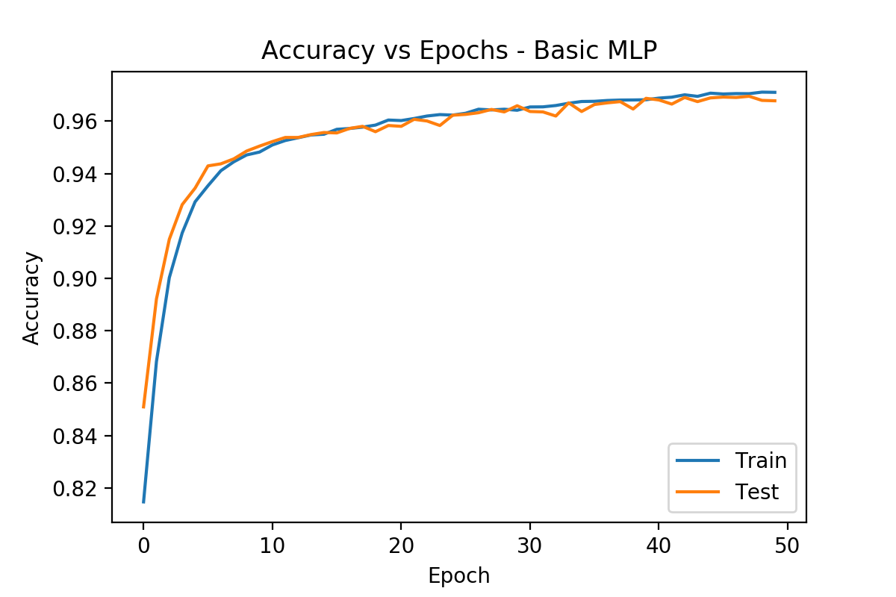
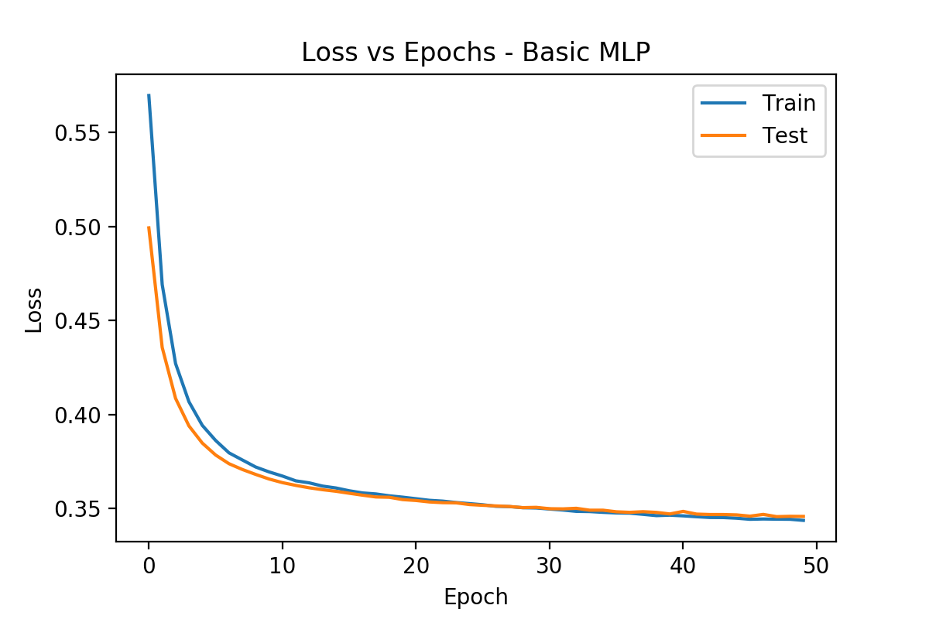
Mini Challenge - Results
Accuracy & Loss vs Epoches - Multi-Layer Perceptron Model
Total training time: 340.37s (5.67m)
Learning rate: 0.01
Batch size: 64

Slide 16
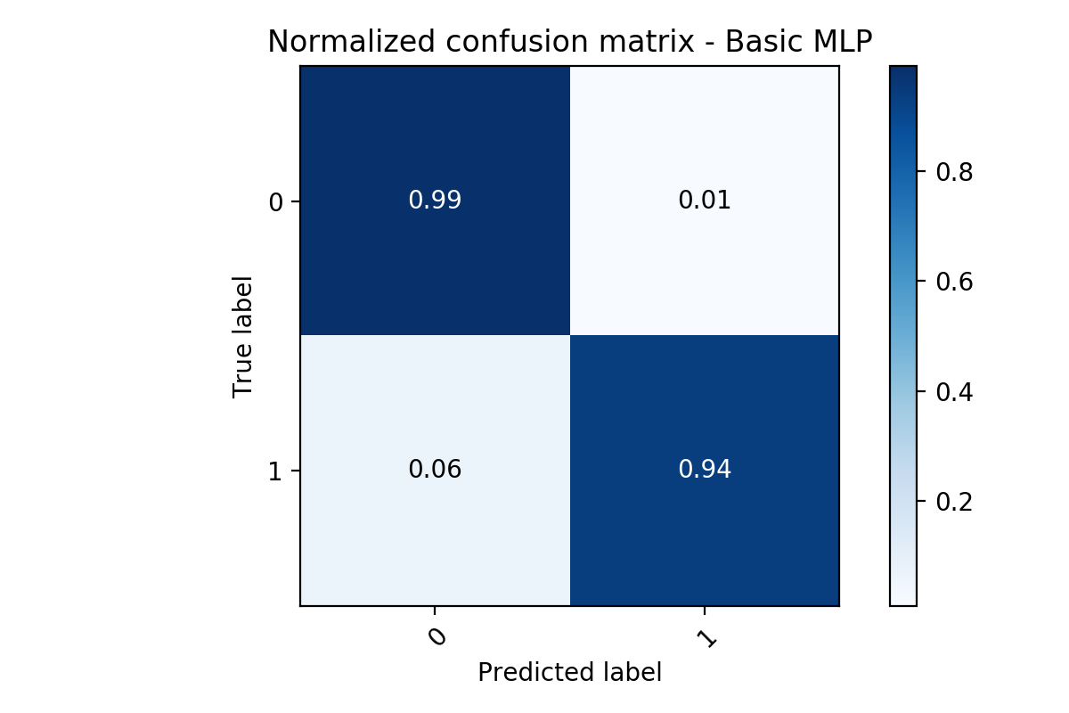
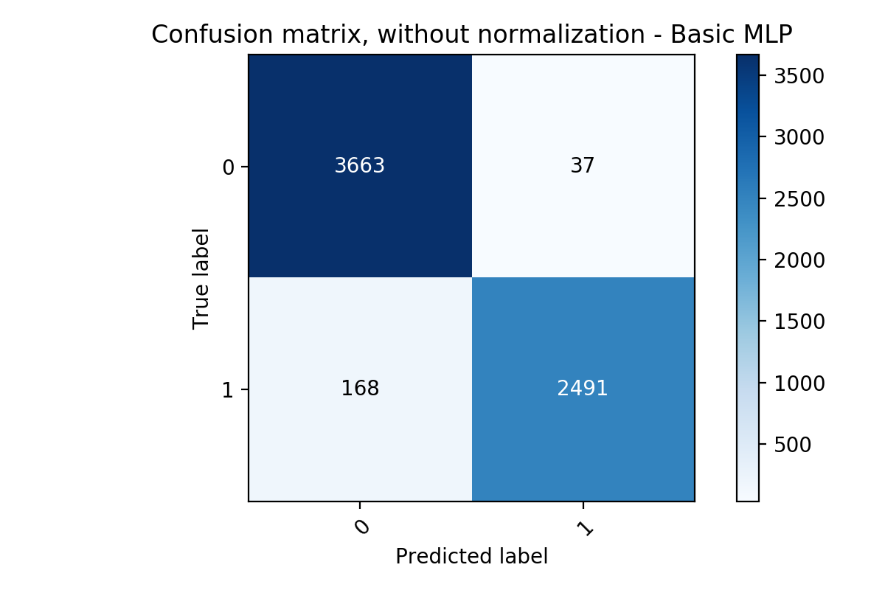
Mini Challenge - Results
Confusion Matrix - Multi-Layer Perceptron Model

Slide 17
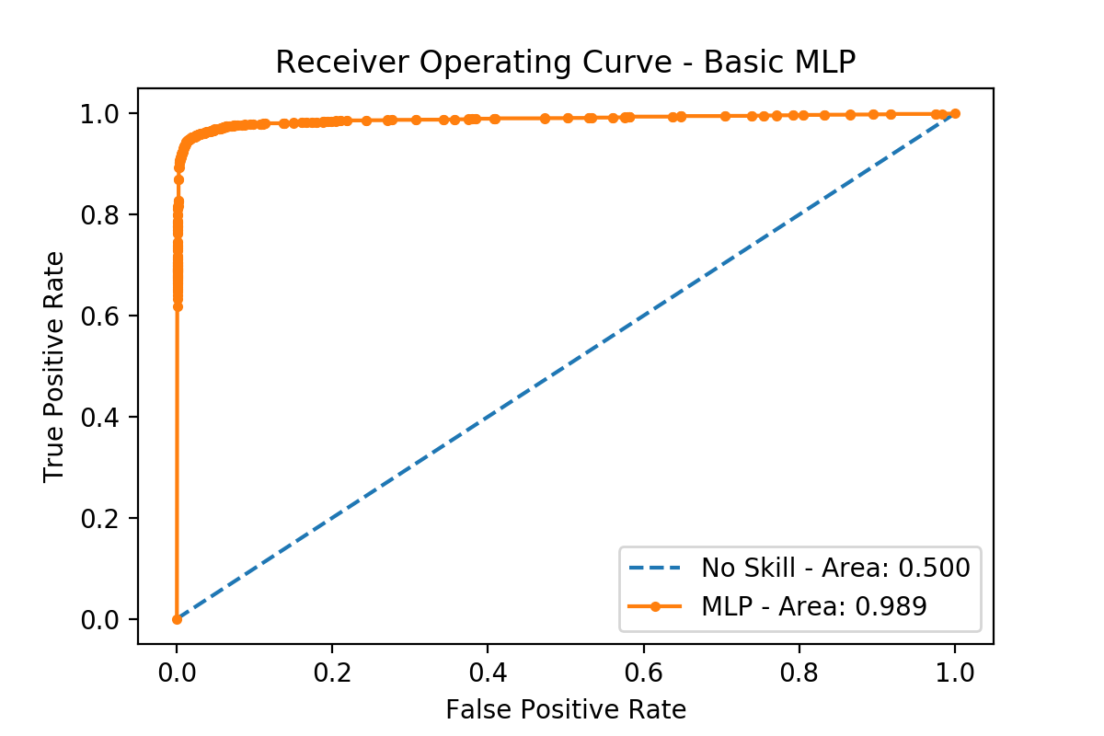
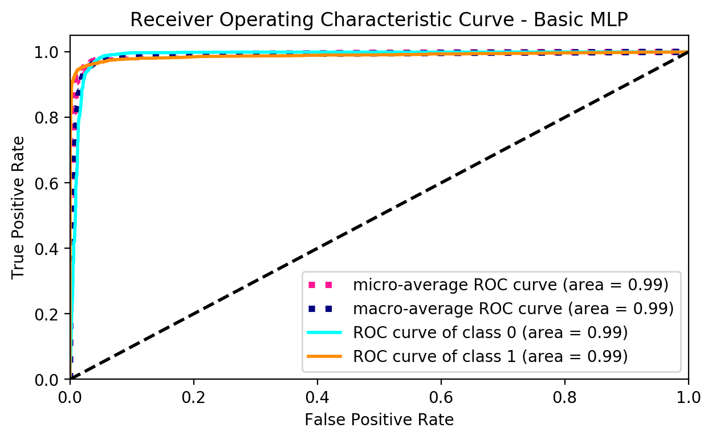
Mini Challenge - Results
ROC Curve - Multi-Layer Perceptron Model

Slide 18
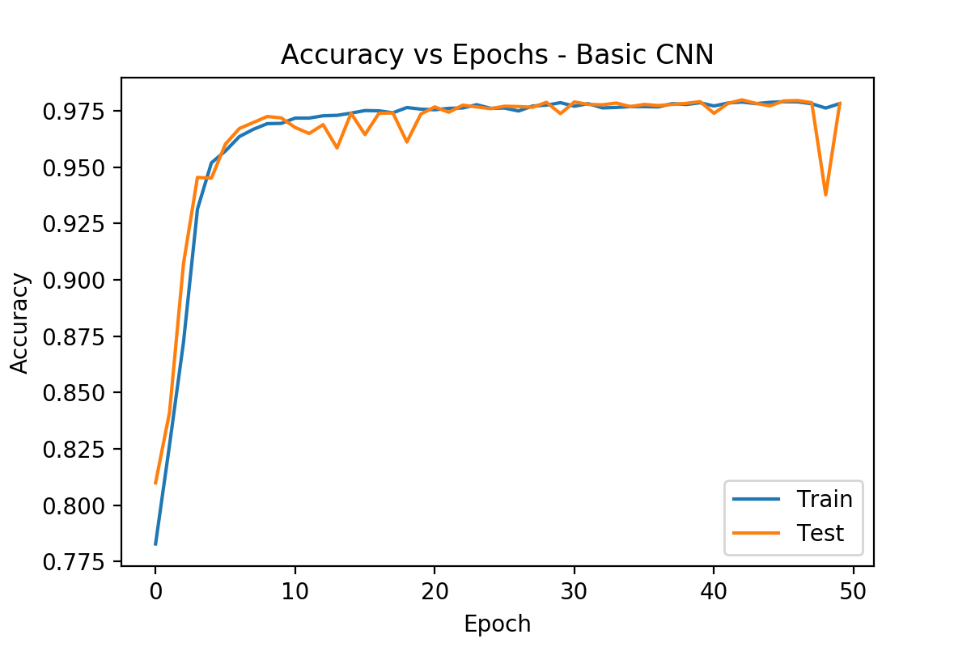
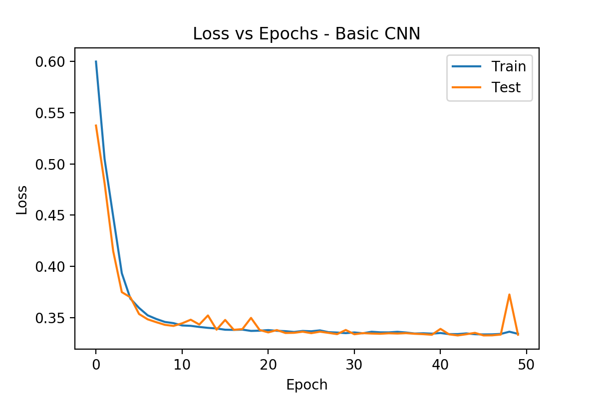
Mini Challenge - Results
Accuracy & Loss vs Epoches - Convolutional Neural Network
Total training time: 820.72s (13.68m)
Learning rate: 0.01
Batch size: 64

Slide 19
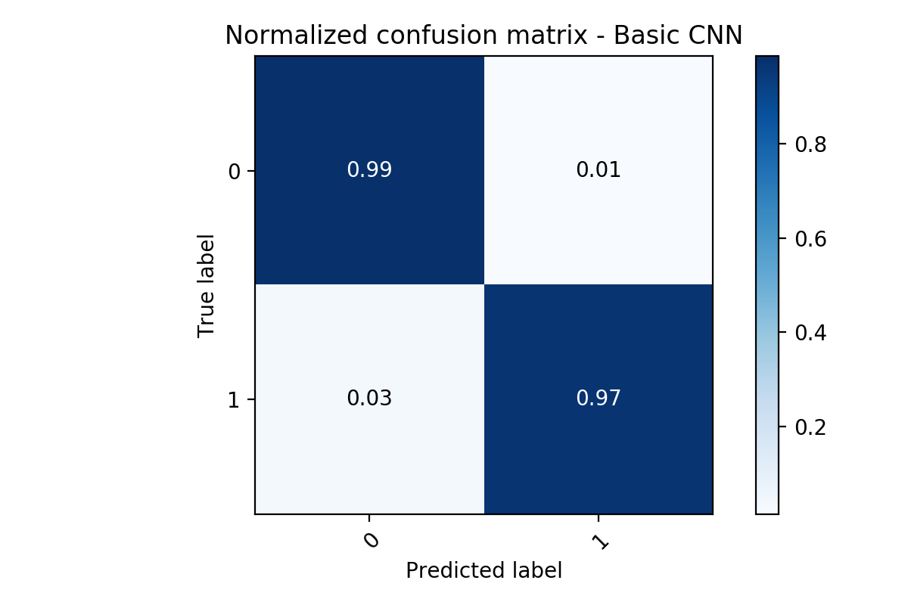

Mini Challenge - Results
Confusion Matrix - Convolutional Neural Networks

Slide 20
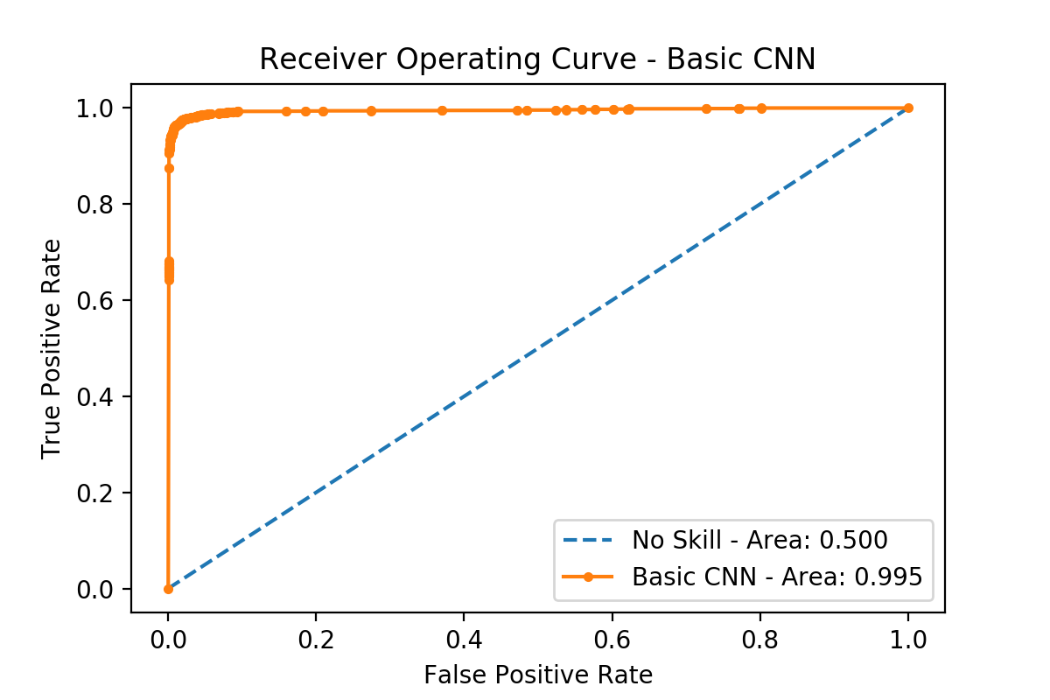
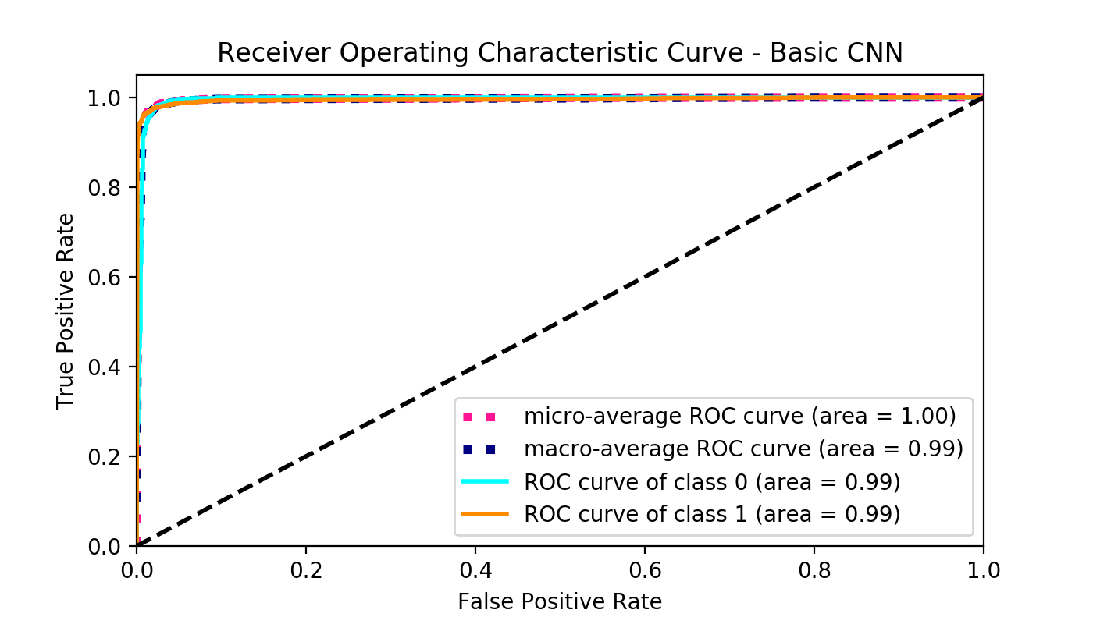
Mini Challenge - Results
Confusion Matrix - Convolutional Neural Networks

Slide 21
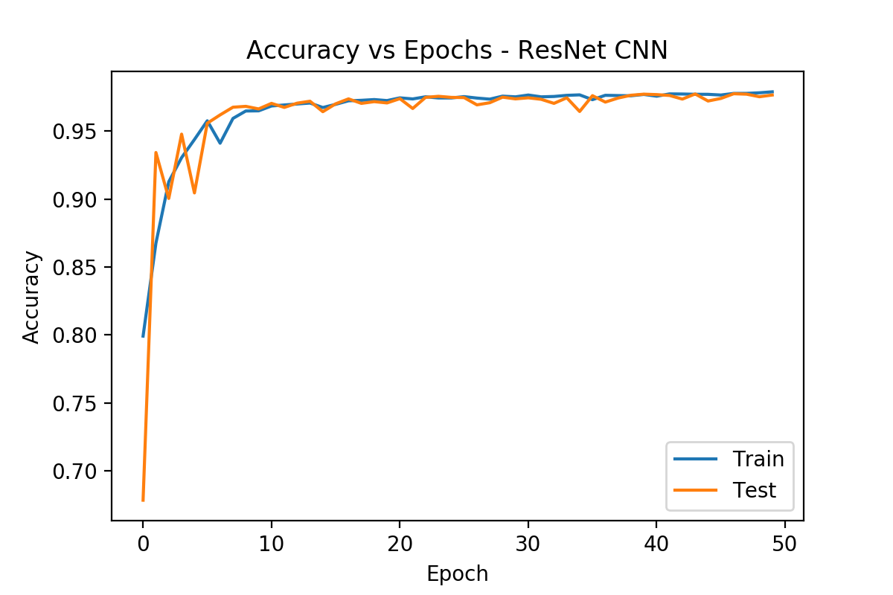
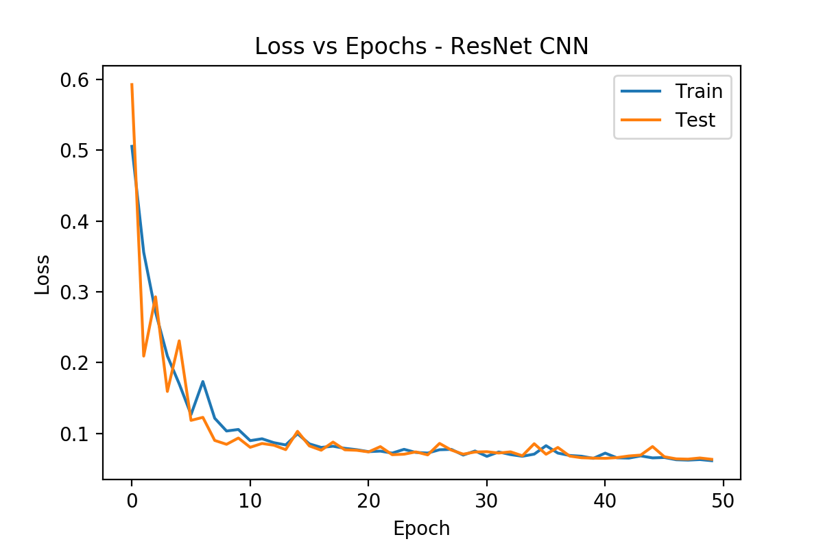
Mini Challenge - Results
Accuracy & Loss vs Epoches - ResNet CNN
Total training time: 1193.01s (19.88m)
Learning rate: 0.01
Batch size: 64

Slide 22


Mini Challenge - Results
Confusion Matrix - ResNet CNN

Slide 23
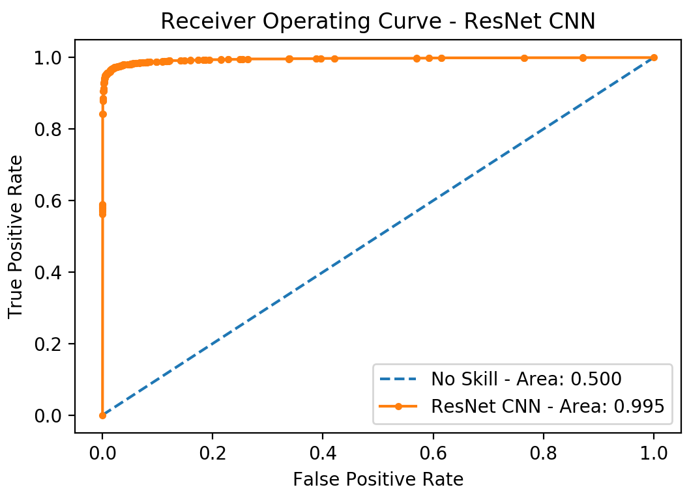
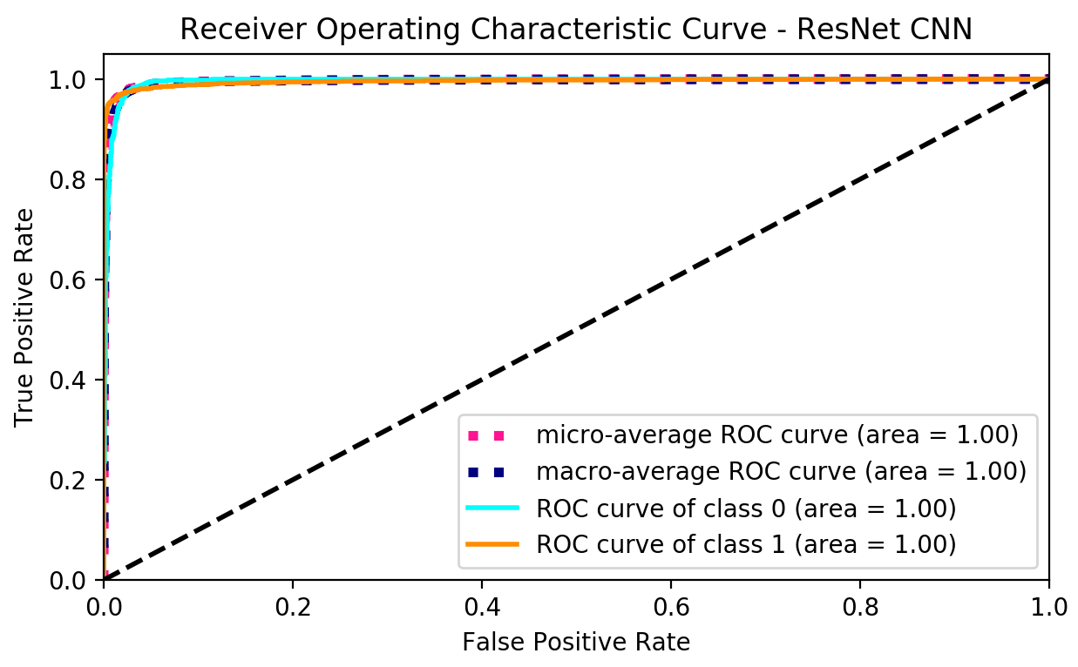
Mini Challenge - Results
Confusion Matrix - ResNet CNN

Slide 24
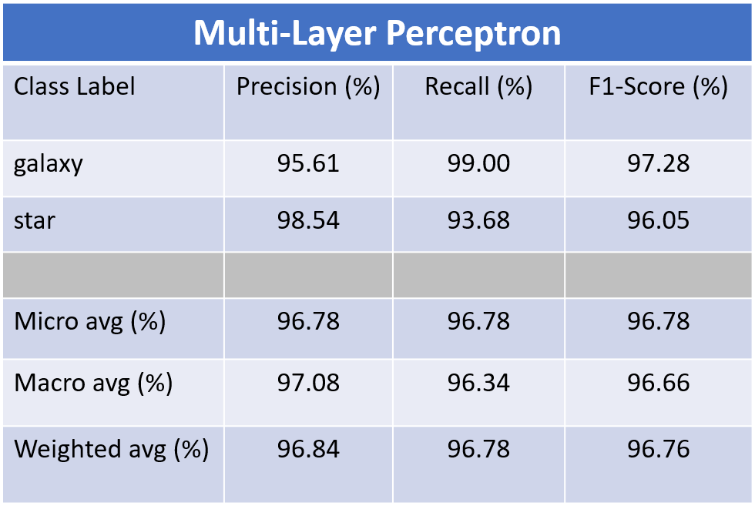
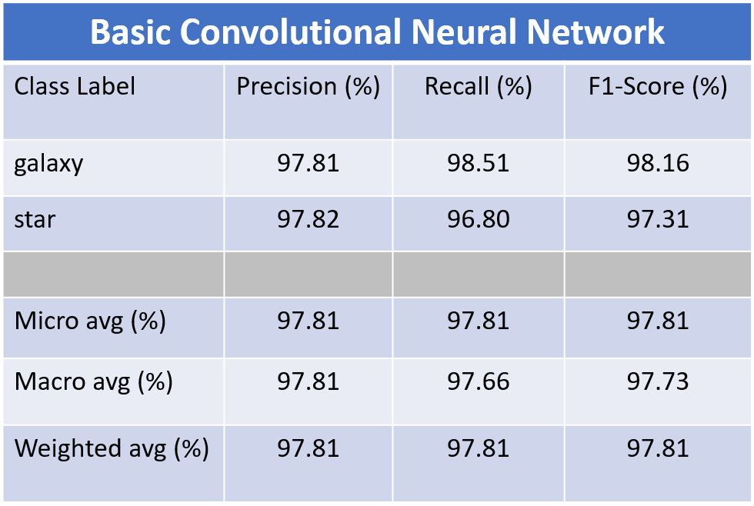
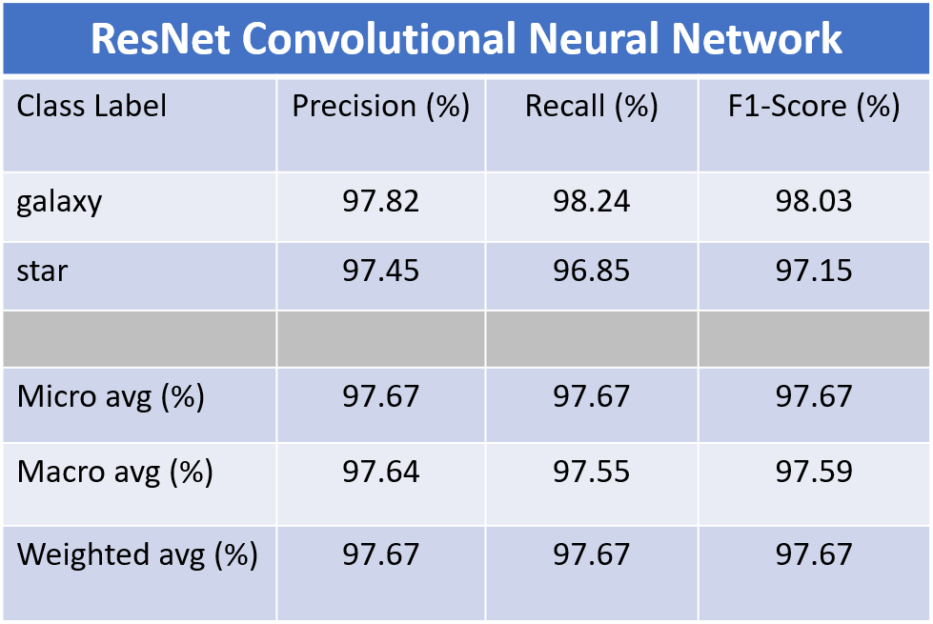
Mini Challenge - Results
Overall Model Metrics
Overall best performance was achieved by Basic Convolutional Neural Network model.
1) Basic Convolutional Neural Network
2) ResNet Convolutional Neural Network
3) Multi-Layer Perceptron
MLP model achieved impressive recall score for galaxy data
Notes:
Go through each one , the highest, which model best recall galaxy, Highlight the best results.

Slide 25
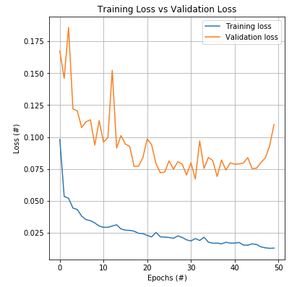
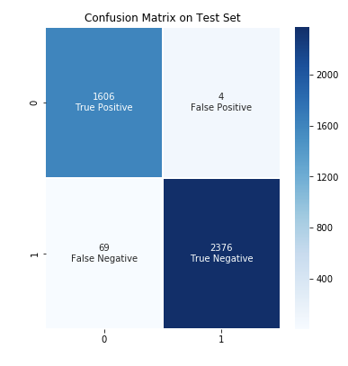
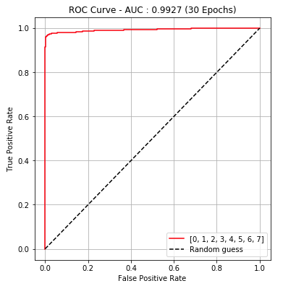
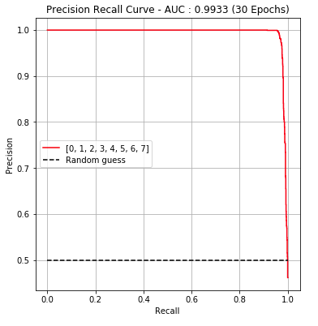
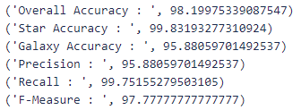
Mini Challenge - Results - Band Configurations
CNN Model - Performance with all bands
Optimal Model Complexity @ 30 epochs
50 epoch train time : 15 mins 29 secs
30 epoch train time : 08 mins 05 secs
Other Performance Metrics:

Slide 26
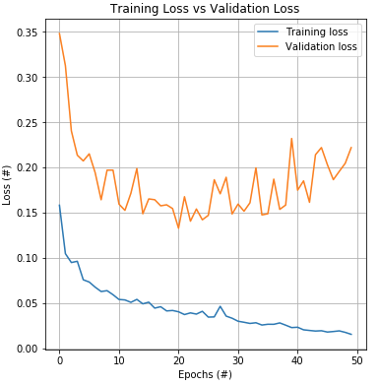
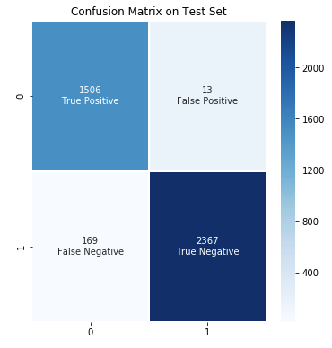
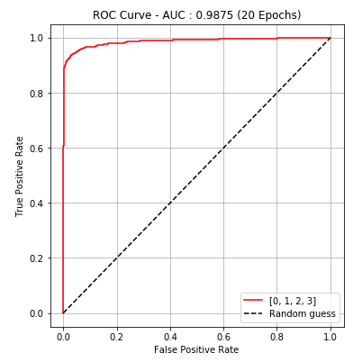
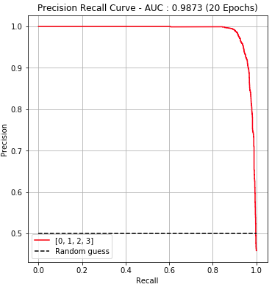
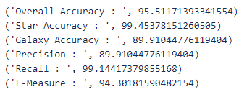
Mini Challenge - Results - Band Configurations
CNN Model - Performance with bands 0 - 3
Optimal Model Complexity @ 20 epochs
50 epoch train time : 07 mins 55 secs
20 epoch train time : 02 mins 57 secs
Other Performance Metrics:

Slide 27
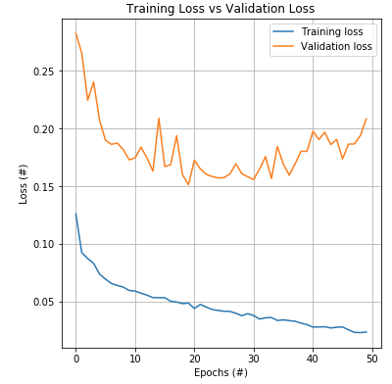




Mini Challenge - Results - Band Configurations
CNN Model - Performance with bands 0, 4
Optimal Model Complexity @ 20 epochs
50 epoch train time : 08 mins 41 secs
20 epoch train time : 04 mins 57 secs
Other Performance Metrics:

Slide 28





Mini Challenge - Results - Band Configurations
CNN Model - Performance with bands 1, 5
Optimal Model Complexity @ 30 epochs
50 epoch train time : 07 mins 18 secs
30 epoch train time : 06 mins 23 secs
Other Performance Metrics:

Slide 29





Mini Challenge - Results - Band Configurations
CNN Model - Performance with bands 2, 6
Optimal Model Complexity @ 25 epochs
50 epoch train time : 07 mins 36 secs
25 epoch train time : 07 mins 31 secs
Other Performance Metrics:

Slide 30





Mini Challenge - Results - Band Configurations
CNN Model - Performance with bands 3, 7
Optimal Model Complexity @ 25 epochs
50 epoch train time : 12 mins 19 secs
25 epoch train time : 07 mins 27 secs
Other Performance Metrics:

Slide 31






Mini Challenge - Results - Band Configurations
CNN Model - Overall Metrics for Each Configuration

Slide 32
Outline
Team 4 Introduction
Background
Mini Challenge
Major Challenge
Summary
Acknowledgement

Slide 33



Main Challenge - Intro
Asteroid Detection
Difference Images (3080x3072 px)
Individual Asteroid Images (26x26)

Slide 34

Main Challenge - Intro
Asteroid Detection
Every big (approx. 3000x3000) difference images has a Pandas DataFrame
Streaks are objects moving in a straight line (asteroids in this case).
Magnitude = Magnitude of the streak
Length = Length of the streak
Angle = Angle of the streak
Box coordinates of the injected asteroids
width = ‘length’ + 100
height = ‘length’ + 100

Slide 35

Main Challenge - Intro
Aim
Detect the presence of asteroids in the big (3080x3072 px) difference images.
26x26 boxes around injected asteroids (given targets)
Asteroid images (around red boxes) were extracted to get an asteroid class data set.
Individual Asteroid Images (26x26)

Slide 36

Main Challenge - Methodology

Slide 37

Main Challenge - Methodology
Data Preprocessing
No-Asteroid Data Set
Difference images was randomly sampled with a 50/50 split between asteroid and no-asteroid sample numbers.
Samples were checked to ensure they were not within injected asteroid boxes.
(26x26)
Z-Score Normalization
Normalized to improve model metrics.
Asteroid Data Set
Collected using `asteroid_injected_information_#.npz` files and difference images.
(26 x 26)
Red boxes are the injected asteroids

Slide 38



Main Challenge - Methodology
Model Construction
Sliding Window Model
Basic Convolutional Neural Network
This was exaggerated (200x200 images)
In reality it is (26x26 images)

Slide 39


Main Challenge - Results
Matrix of images believed to be asteroids
Sliding window yielded results
Notice the last predictions were inaccurate
Future work needed
We do not have model metrics yet
Confidence = 1.0
Threshold > 0.99
Sliding_shift = 7 px

Slide 40

Main Challenge - Methodology
Alternative using Object Detection
Notes:
Julian

Slide 41


Main Challenge - Methodology
Alternative using Object Detection
Set up
70/30 Train/Val Data Split
Extract Asteroid locations on the given images
Train Object detection Algorithm on data
Notes:
Julian

Slide 42
Main Challenge - Methodology
Notes:
Julian

Slide 43
Summary
Mini Challenge:
We implemented 3 models (MLP, CNN, ResNET) to perform classification.
All the three models yielded similar results.
Trained CNN model on subset of bands and found the metrics to be fairly similar.
Major Challenge:
Devised two ways of locating asteroids with two CNN models
Sliding Window Method
Region Proposal Network
Compared visual results side by side
With more time, will be able to predict true asteroids among the matrix of observed asteroids

Slide 44






Team 4: Dongwei Sun
Degree: Ph.D, Material science and Bioengineering
Skills: Python, Panda, Numpy, MLP
Things learned: Pytorch, CNN
With more time: PyTorch in depth, cell image application
Notes:
Dongwei

Slide 45
Team 4: Ivan Neto
Degree: Computer Science Undergraduate
Skills: Python, Keras, Scikit-learn
Things learned: PyTorch, Anaconda, Basic Astronomy, Working with Images
With more time: PyTorch in depth, optimizing my models better, regularization in depth

Slide 46
Team 4: Ponmanikandan Velmurugan (Mani)
Degree: Masters’ in Computer Science
Skills: Python, Numpy, Pandas, Sklearn
Things learned: Pytorch, Neural Networks, GitHub, Big datasets, Image processing
With more time: K-fold cross validation, Different models, Modelling with GPU

Slide 47
Team 4: Kaichun Chen(Kevin)
Degree:Physics Undergraduate
Skills:Python
Things learned:PyTorch, Working with Images
With more time:Get familiar with Pytorch, using and optimizing models.

Slide 48
Team 4: Julin
Degree: Masters of Science in Computer Science
Skills: Python, Detecto, Pytorch
Things learned: Detecto, cleaning data
With more time: Get the model more accurate
Notes:
Julian

Slide 49





Acknowledgements
Professor Vagelis Papalexakis
Jen Bellig
Brian Gallagher
Ryan Dana
Braden Soper
LC Support Team
All the lecturer speakers
Other teams
Notes:
Julian Beaulieu

